Slide 1
do less. make it mean more.

Slide 2


ignite
Builds the revenue roadmap and links commercial strategy and execution
Ignite is an AI-powered SaaS (Strategy as a Service) revenue enablement and analytics offering that builds and bridges the gap between strategic revenue planning to execution.
Ignite empowers companies of all sizes to enhance revenue effectiveness and confidently streamline commercial operations by providing customized insights and actionable roadmaps.

Slide 3

the challenge to achieve top revenue performance
Team expertise gaps create a disconnect between reports, data, and insights, making it hard to determine necessary actions.
Available insights rarely transform into actionable plans for sales and marketing teams.
Sales and marketing teams hesitate to adopt innovative strategies, relying instead on outdated methods.
Resources are wasted preparing documents for owners, investors, and internal meetings.

Slide 4




absence of single-source reporting
Despite over 60 reports and seven systems, no central hub combines reports and insights.
lack of actionable insights
Less than 5% of marketing and sales tactics align with the most profitable customers or segments.
what does that really mean?
overlooked potential
3-5% revenue growth / uncovered overlooked revenue opportunities.
These challenges lead to inefficient operations, wasted resources, and stagnant growth.
outdated strategies
Sales teams apply obsolete playbooks from the 1970s, expecting to achieve today's desired results.
inefficient resource allocation
Over three months spent on reporting and prep work for internal meetings.

Slide 5

the strategy-execution
connection
There’s no shortage of tools to enhance
success, but businesses often struggle with execution.
This is where Ignite steps in.
Our approach connects strategy with execution, making it straightforward.
We use AI data-driven insights to facilitate
decisions and promote continuous
improvement and agility, giving your business
a competitive edge.

Slide 6



Comprehensive BI: consolidates data into a single source of truth.
Actionable insights: that exceed basic data analysis.
Detailed playbook: facilitates strategy execution and operational excellence.
AI & predictive analytics: for better-informed decision-making.
Targeted: focuses on valuable segments for efficient execution.
the ignite solution
Ignite is a solution that transforms organizations' data management and analysis.
By consolidating information into one source of truth, Ignite offers teams actionable insights beyond basic analysis.

Slide 7
ignite demo

Slide 8
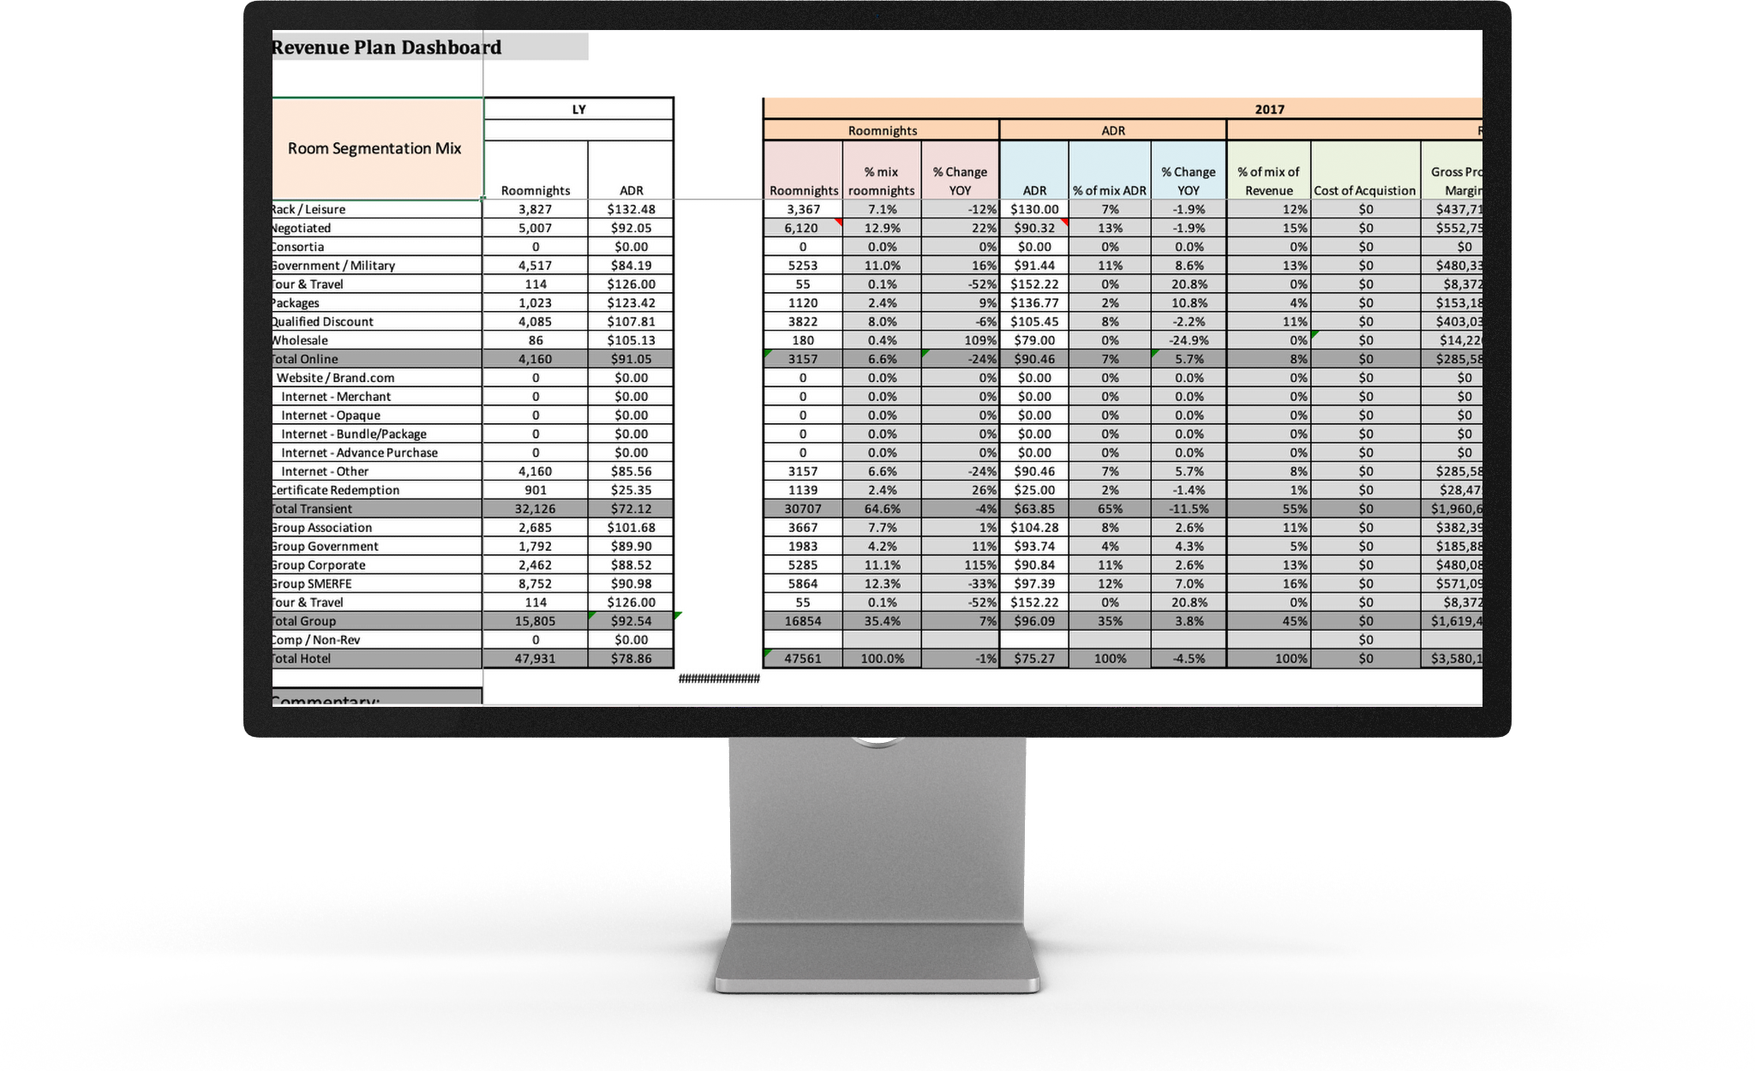
The first version of Ignite: Ignite began as an Excel spreadsheet to determine essential revenue information.

Slide 9
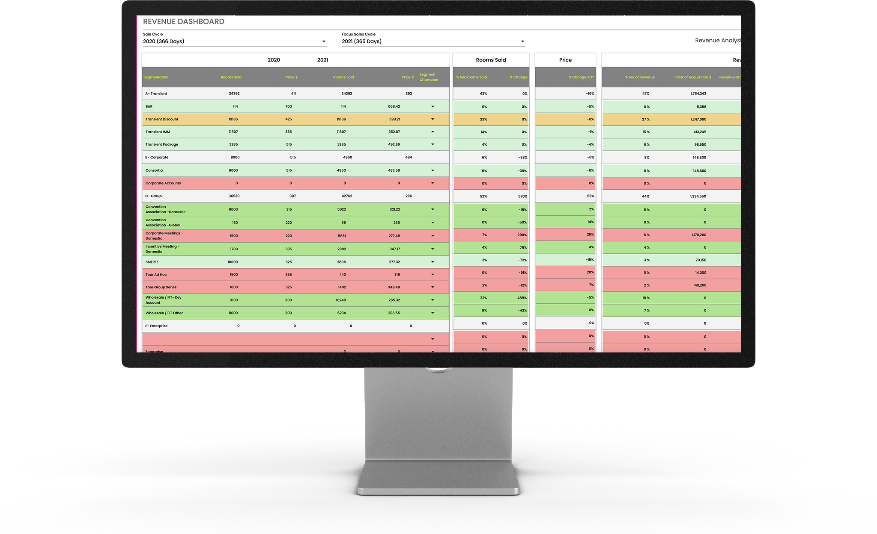
The current version of Ignite: Ignite was developed into a SaaS program with expanded functionality. This version is currently used to create revenue strategy with clients but needs further development.

Slide 10
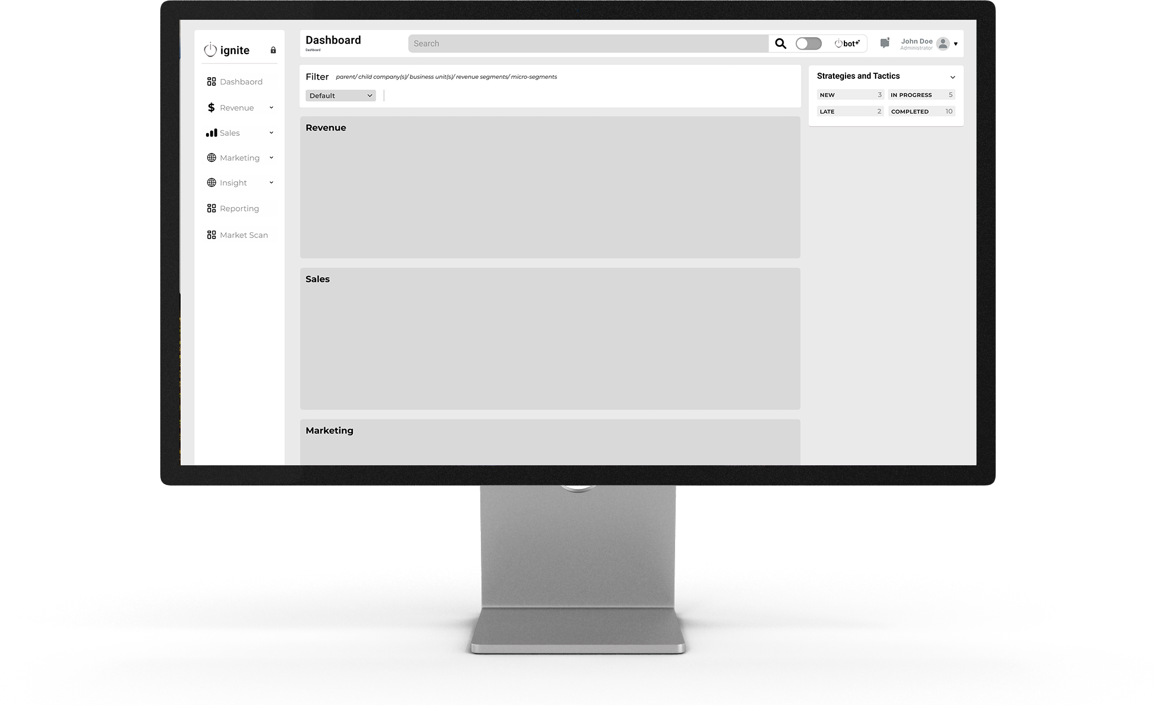
Main dashboard: Once logged in, users will be presented with a clean, simple snapshot that shows all strategies and tactics related to Revenue, Sales, and Marketing.

Slide 11
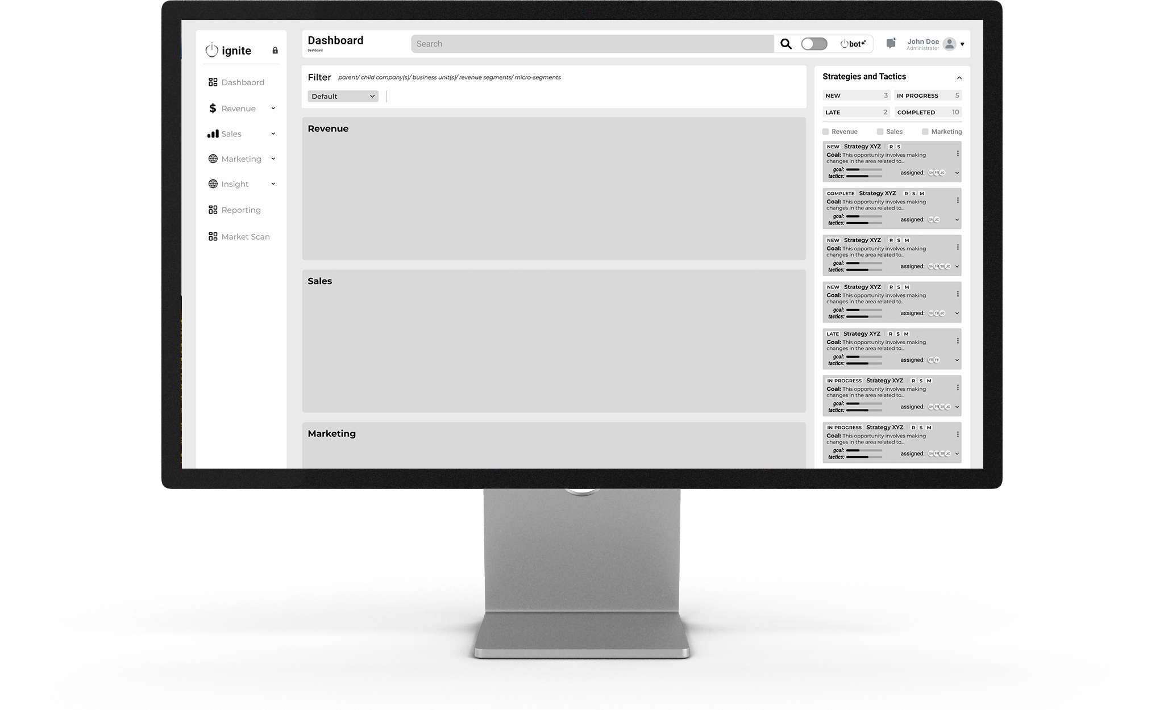
Main dashboard: Strategies and Tactics are shown with a progress bar showing the movement toward completion of the final goal, the team members assigned to each Strategy and Tactic, and the status.

Slide 12
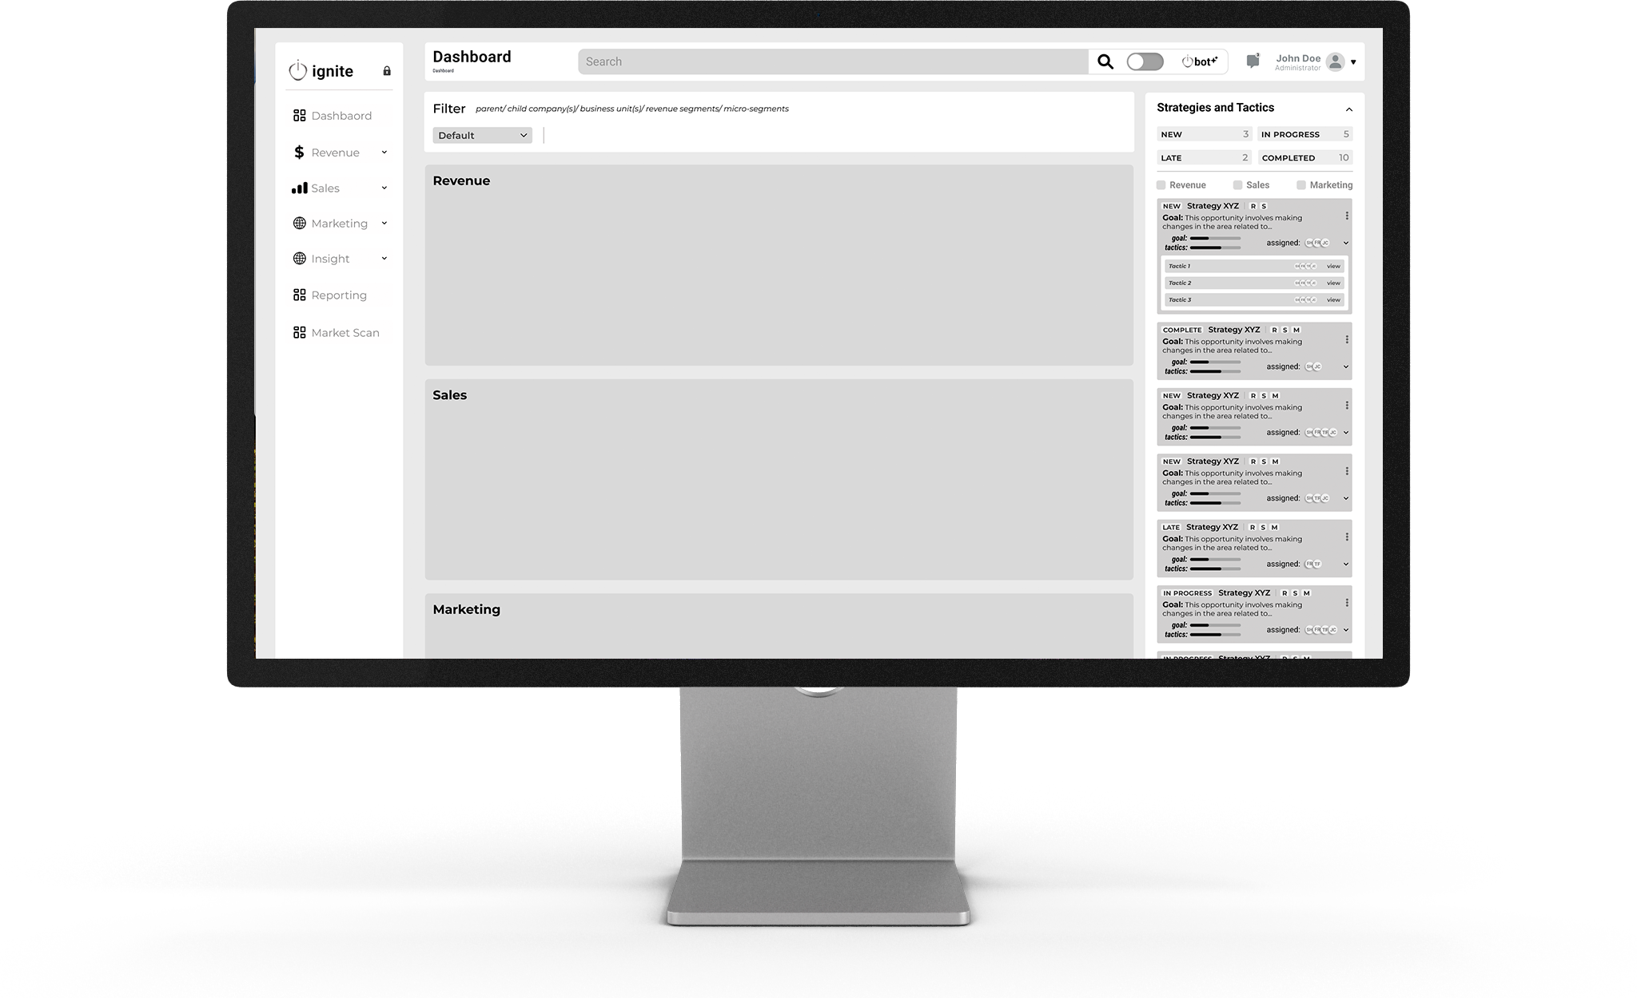
Main dashboard: Each Strategy will expand to show all Tactics needed to reach the final goal of the Strategy. Each team member will be able to access the information relevant to their position to keep informed of their list of tasks to complete.

Slide 13
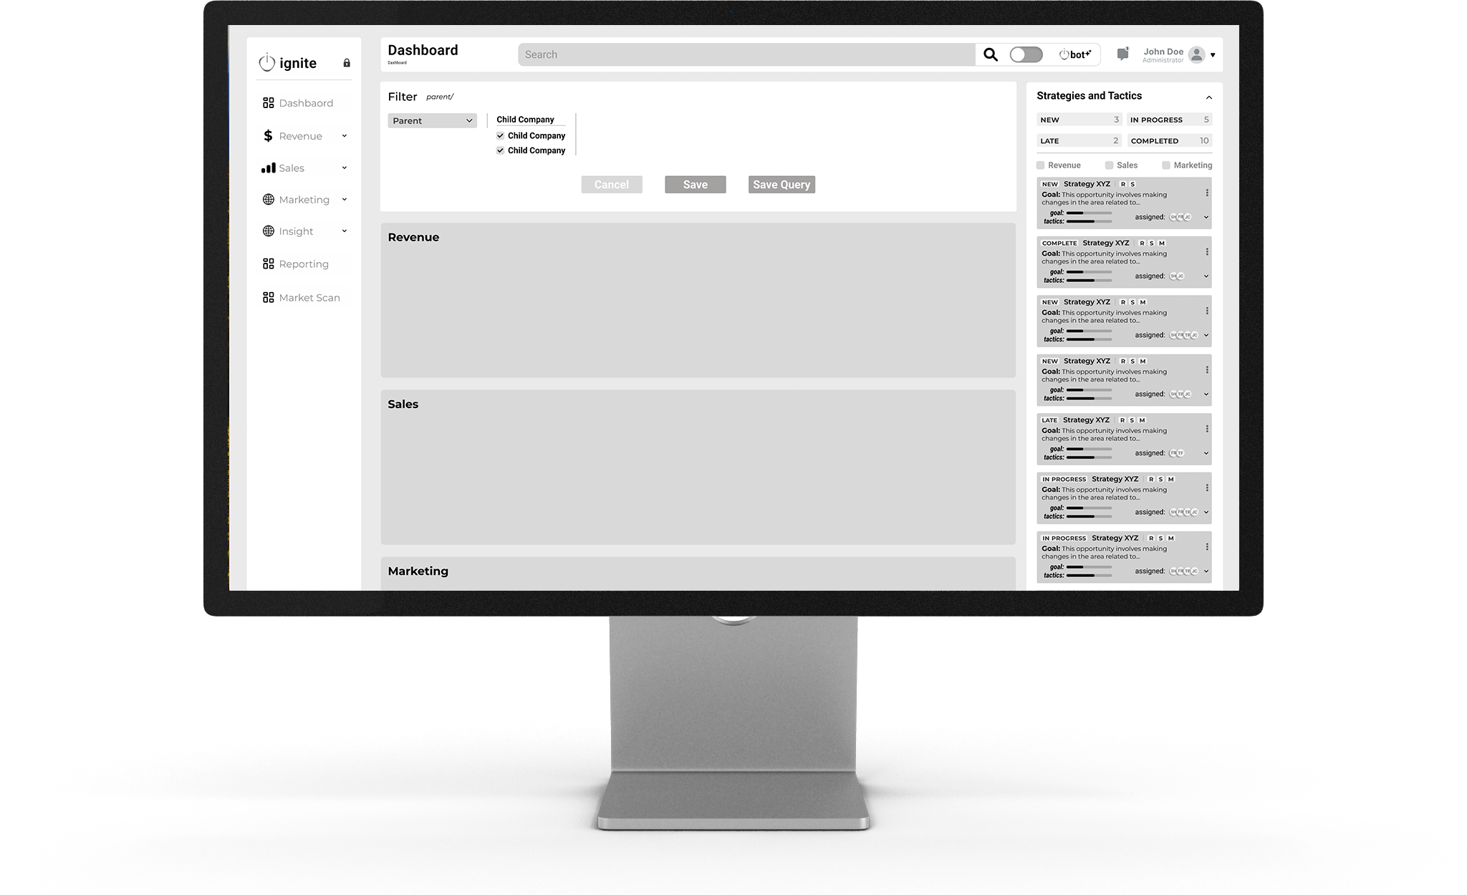
Main dashboard: The dashboard can filter the strategies based on certain criteria determined by the client.

Slide 14
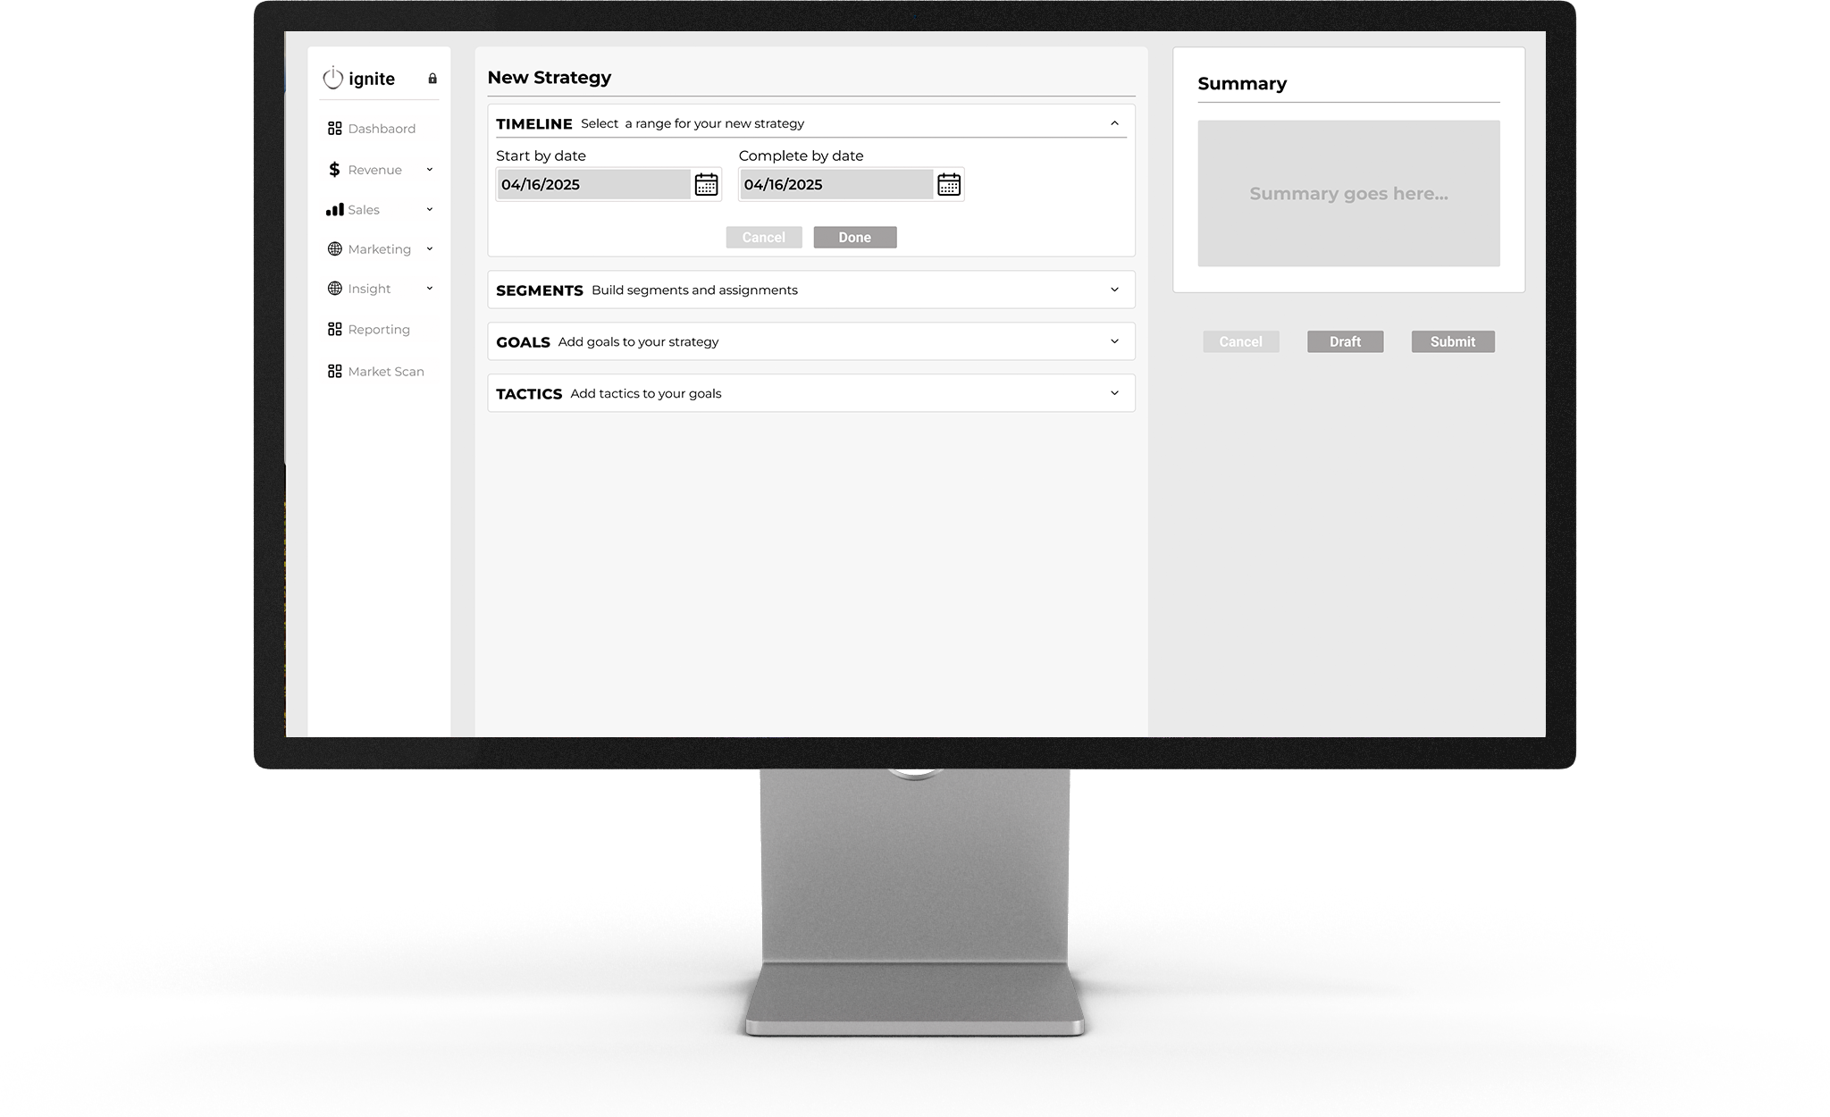
Creating a New Strategy: Strategies can be easily created in Ignite. First, a date range is entered.

Slide 15
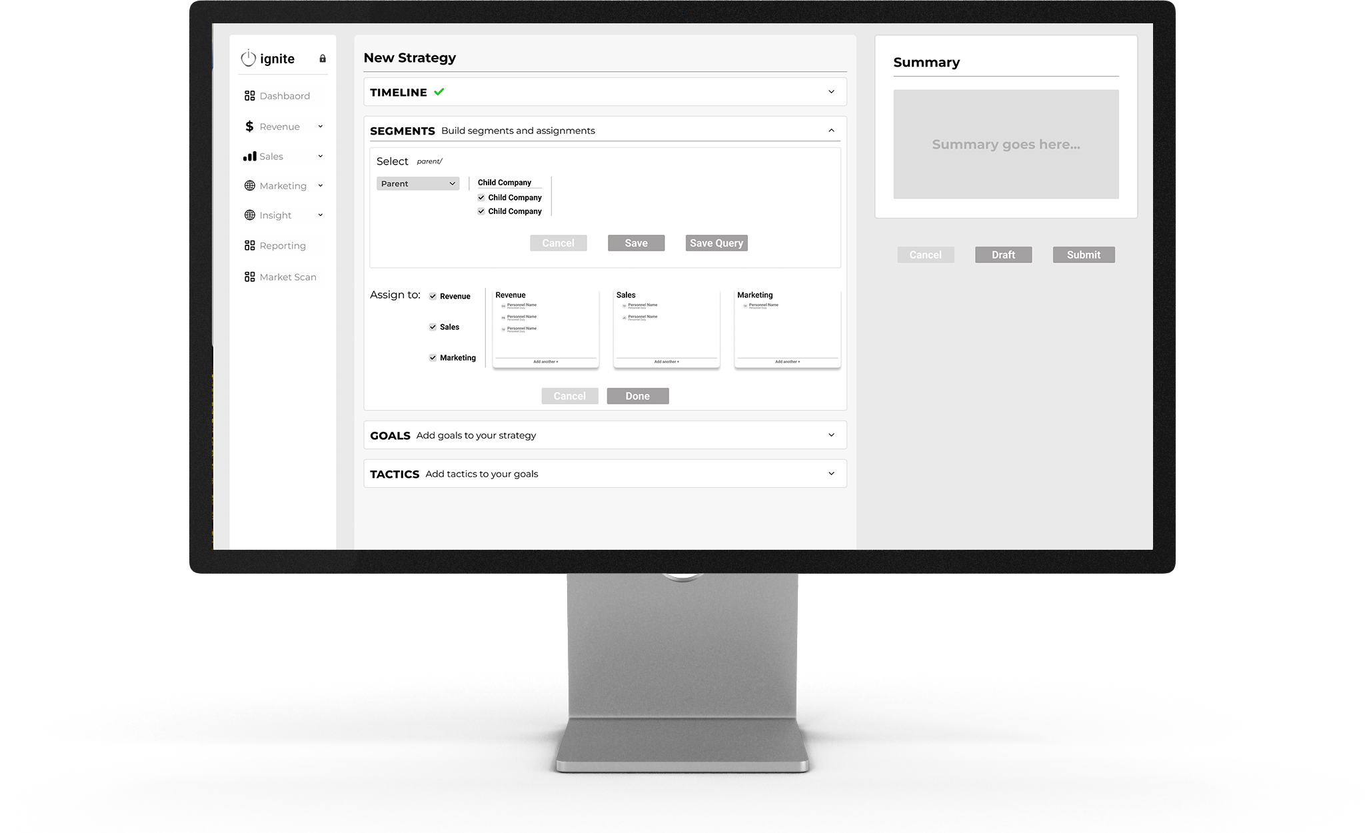
Creating a New Strategy: Then, the appropriate category is assigned to the strategy. This could be by brand, location, division, or other based on a client’s business structure.

Slide 16
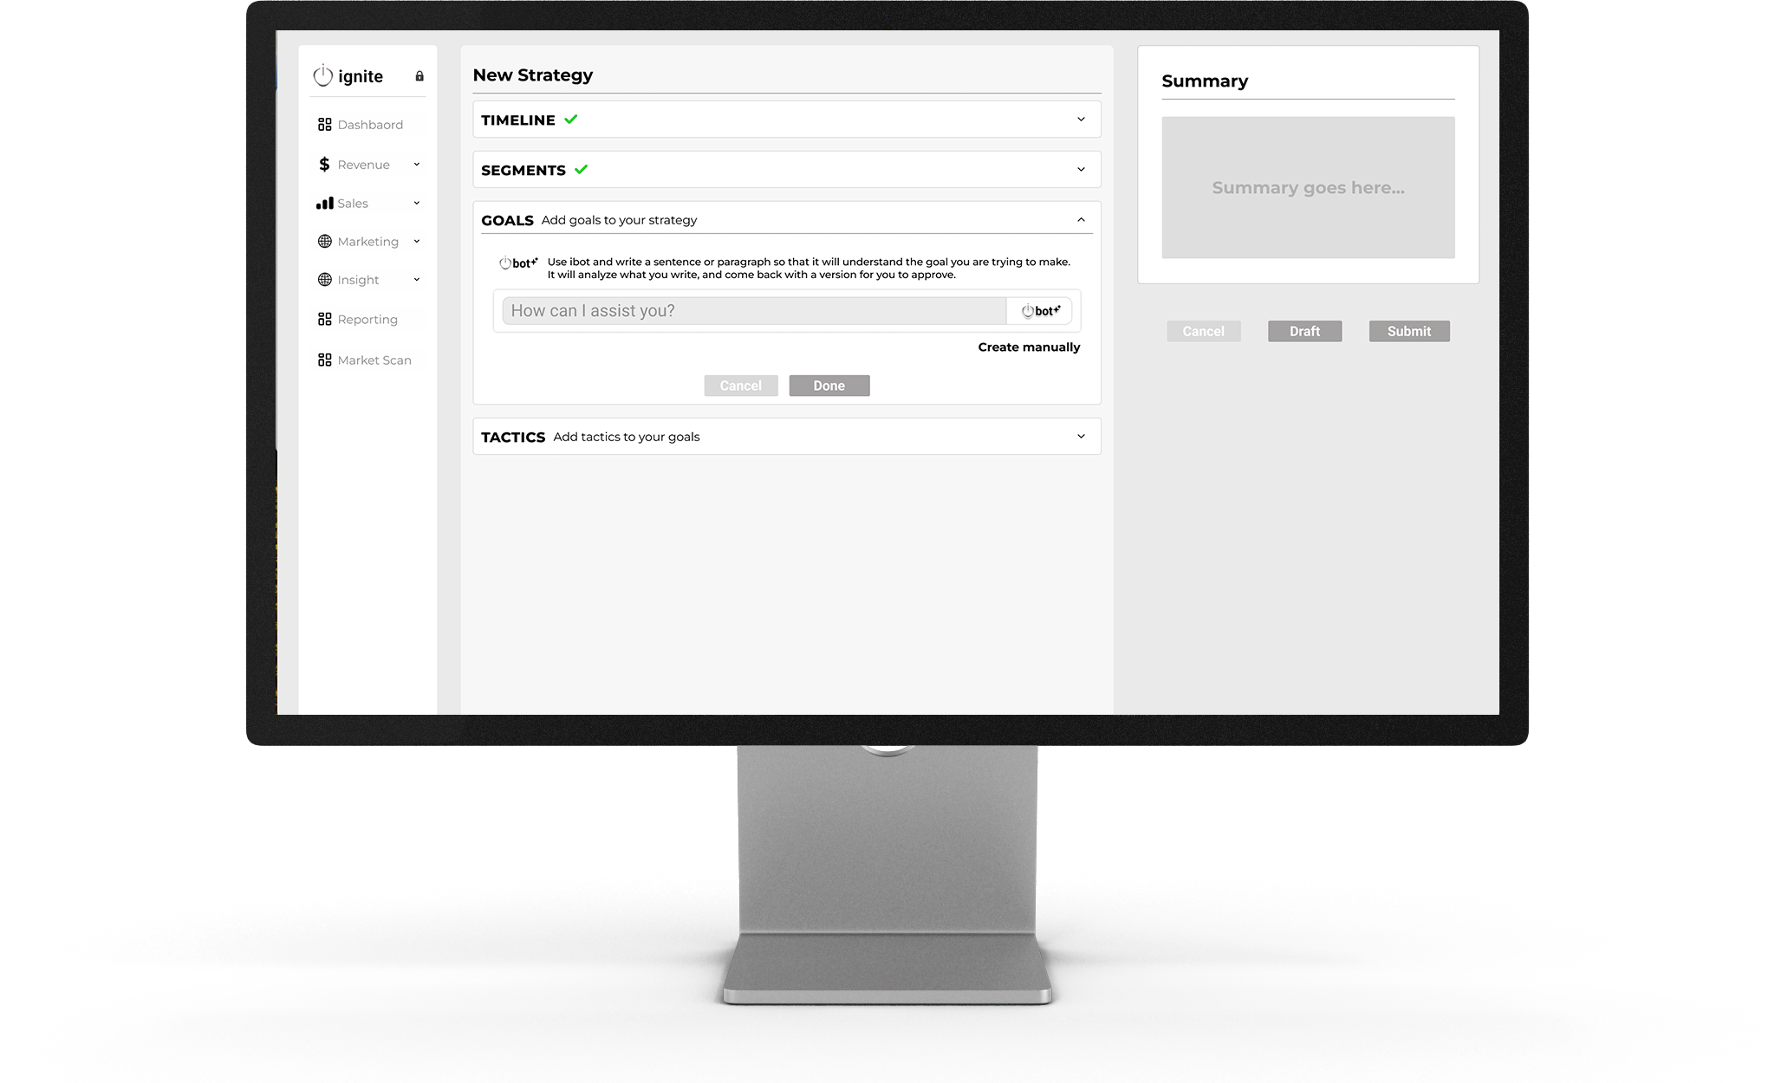
Creating a New Strategy: When creating a new strategy, the user has the option to get AI strategy recommendations. This can be easily switched to manual entry if the user has specific tactics they’d like to use.

Slide 17
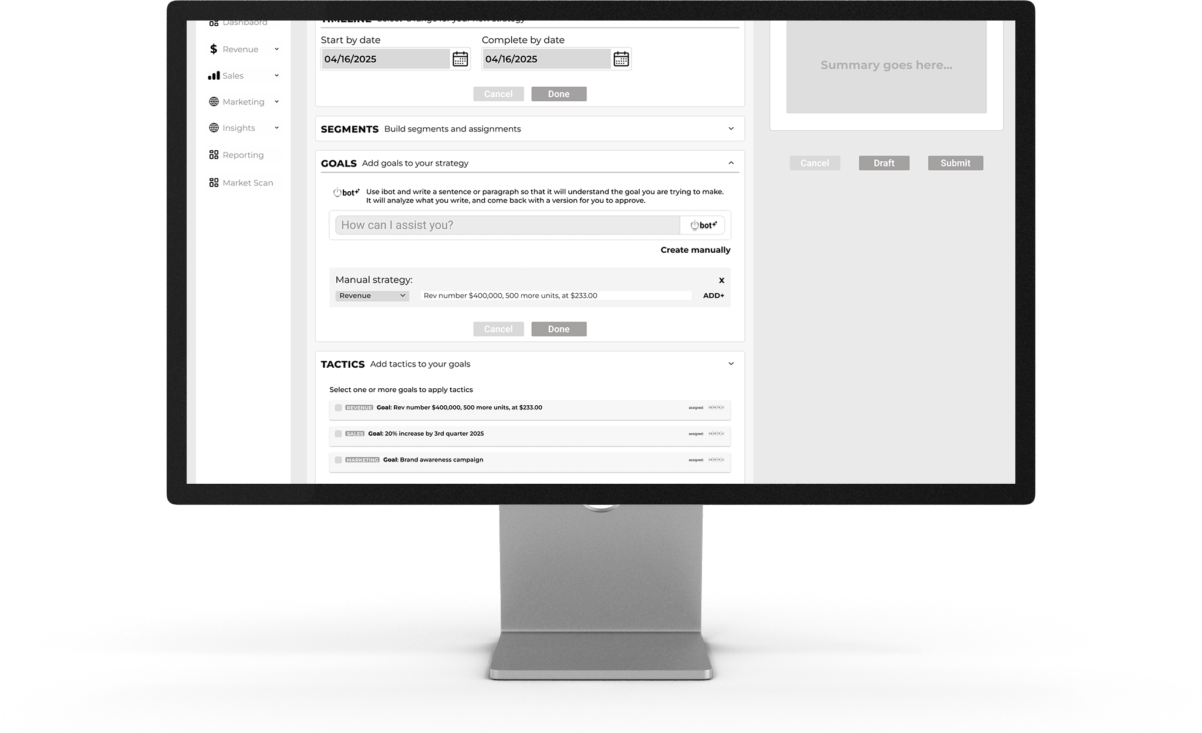
Creating a New Strategy: Appropriate tactics will be generated based on the overall goal of the strategy.

Slide 18
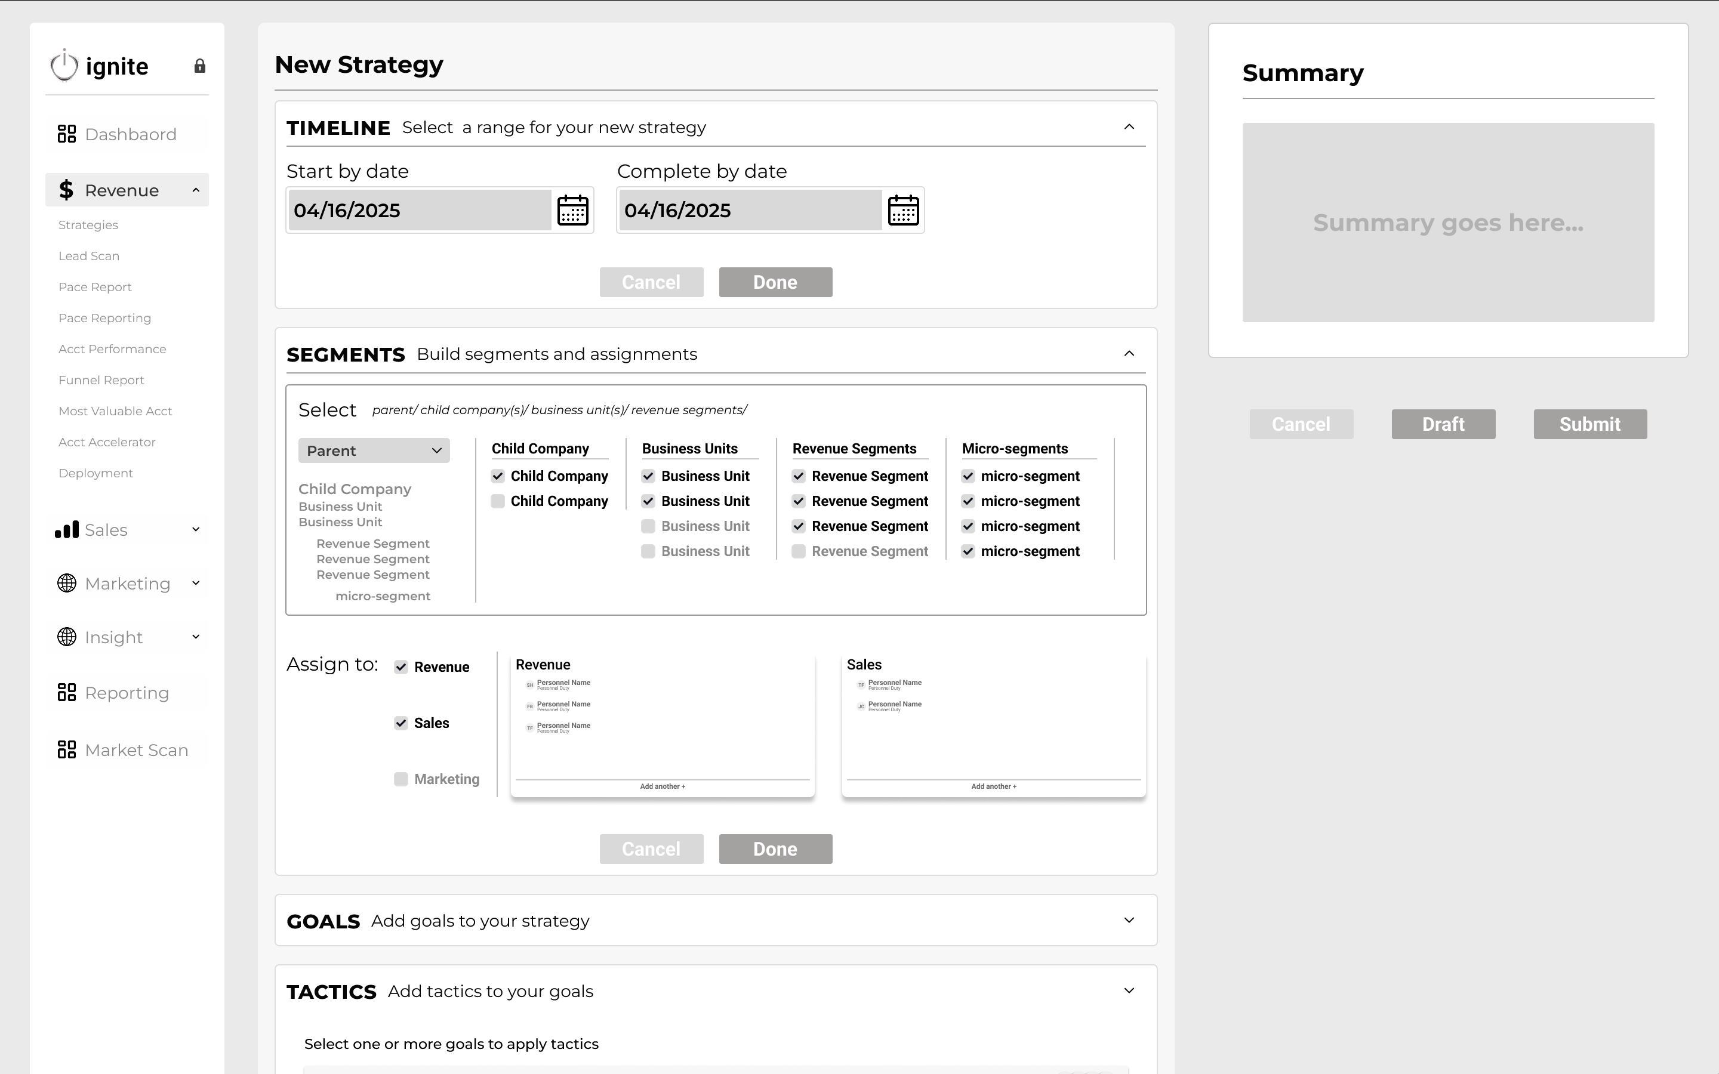
Strategy within Teams: Ability to create cross functional integration within teams.

Slide 19



ignite subscription levels
blaze
An advanced AI and machine learning analytics tool for informed decision-making.
Ignite offers two different subscription models tailored to the needs of a diverse range of businesses.
spark
A tailored solution for smaller businesses offering templated solutions.
Each subscription level offers efficient execution with real-time tracking, analytics, and optimization.
thought library
A resource of best practices, case studies, and frameworks for optimal business operations.

Slide 20

target audience
Ignite targets businesses recognizing the need for transformative approaches to enhance efficiency and drive growth. This audience values agility and innovation and is eager to adopt cutting-edge solutions for a competitive edge.
hospitality
Ignite's solution empowers the hospitality industry by streamlining operations through automation, enhancing guest experiences, and increasing operational efficiencies.
startups / SMEs
For startups and SMEs, Ignite’s technology provides scalable, cost-effective tools that enable rapid growth and market adaptability, ensuring these businesses stay ahead in a competitive landscape.
retail
Our innovative solution improves customer engagement and marketing effectiveness in retail, driving higher sales, improved retention, and greater customer satisfaction.

Slide 21



business model
Ignite generates income through multiple streams and offers flexible tiers for businesses of all sizes. We also earn revenue from premium upgrades that enhance customer experience. This approach stabilizes our cash flow and allows us to adapt quickly to market demands, positioning us for sustained growth.
revenue streams
Subscriptions:
Yearly plans with tiered pricing
Premium upgrades:
Add-on options for advanced analytics and custom reporting
Consulting services:
Tailored planning and implementation strategies
customer segments
Enterprise:
Comprehensive plans with advanced features and dedicated support
Startups / SMEs:
Affordable subscription plans with essential features.
scalability
Upsell potential:
Offer premium features and consulting services.
Flexible platform:
Easily scale to suit the needs of a diverse range of businesses.

Slide 22




go-to-market strategy
customer acquisition channels
marketing strategies
Digital Marketing: SEO, content marketing, and social media campaigns to create awareness and drive inbound leads.
Partnerships: Collaborations with industry associations, ERP providers, and consulting firms.
Direct Sales: Outreach initiatives, webinars, and demonstrations targeting decision-makers in key
Brand Awareness: To build credibility, use thought leadership content, case studies, and industry events.
Lead Generation: Targeted campaigns, whitepapers, and gated content to capture and nurture leads.
Customer Engagement: Regular webinars, newsletters, and user communities for ongoing
sales strategy
customer adoption
Target Customers: SMEs and large enterprises in retail and hospitality.
Sales Funnel Optimization: Streamlined process from lead capture to conversion.
Metrics and KPIs: CAC, CLTV, and conversion rates to measure and optimize performance.
User Guiding: Intuitive interfaces quickly craft actions
Visibility: Transparency for the entire team
Incentives: Gamification provides incentives for team members to reach goals

Slide 23
the competition
Ignite excels by combining advanced AI-driven financial insights with industry-specific customization, turning strategic financial plans into clear, actionable roadmaps that boost revenue.
Revenue Modeling
ProfitWell
Cube
Adaptive Insights (Workday)
Data Aggregators
Domo
Tableau
Zoho Analytics
Strategy & Tactics Creation
Gtmhub
Perdoo
Ally.io (Microsoft Viva Goals)
Performance Metrics
Salesforce
Hubspot
Pipedrive
Gamification on KPIs
Spinify
Hoopla
Ambition

Slide 24
market size and growth potential
By 2030
$54.27B
$36.4B
$10.9B
$546M
CAGR 9.1%
Business Intelligence Market Size
$29.42B
CAGR 26.7%
AI-Powered SaaS Productivity Tools Market
$6.948B
Target
Total Addressable Market
30 %
Share of market
Total Obtainable Market
5 %
Notes:
1. **SaaS Productivity Tools Market Using AI:**
- The global AI productivity tools market size was estimated at USD 6,948.3 million in 2023 and is projected to grow at a CAGR of 26.7% from 2024 to 2030[5].
2. **Business Intelligence Market Size:**
- The global Business Intelligence market size was estimated at USD 29.42 billion in 2023 and is expected to reach USD 54.27 billion by 2030, growing at a CAGR of 9.1% during the forecast period[2].
- Another source indicates that companies will spend $59.7 billion on Business Intelligence software in 2024, highlighting a significant market size for BI solutions[4].
3. **Expected Growth Over the Next 10 Years:**
- The Business Intelligence market is expected to grow at a CAGR of 9.1% from 2023 to 2030, reaching USD 54.27 billion by 2030[2].
The AI productivity tools market, which includes BI tools that leverage AI, is projected to grow at a CAGR of 26.7% from 2024 to 2030[5].
The overall market size for SaaS productivity tools using AI is significantly smaller than the specific Business Intelligence market. However, both markets are expected to grow considerably over the next decade, with the AI productivity tools market experiencing a much higher growth rate. The Business Intelligence market, which includes tools that connect business financial strategy to sales and marketing execution, is expected to reach USD 54.27 billion by 2030, growing at a CAGR of 9.1%[2].

Slide 25
investment opportunity
Ignite is seeking an investment of $1M to cover an 18-month runway as we finalize and launch our platform. We have commitments from crucial hospitality customers who are ready to adopt Ignite as soon as we go live, ensuring early traction and revenue generation.
$1M
20%
total raise
equity
12 months in development for full product launch
Beta test ready at month 6
Funds will enable sustained growth for marketing, product development, operations, and sales
Company valuation $5M
Covers 18-month runway
Projected revenue: Ignite projects a 37% CAGR over the next five years, aiming for $1.7 million next year and $8.25 million in five years.

Slide 26
growth projections

Slide 27
financial projections
 | MONTH 1 | MONTH 2 | MONTH 3 | Q 1 | Q 2 | Q 3 | Q 4 | YEAR 1 | YEAR 2 | YEAR 3
Organizations | 0 | 0 | 0 | 0 | 0 | 2,625 | 4,350 | 30 | 105 | 160
Users | 0 | 0 | 0 | 0 | 0 | 4,061 | 10,609 | 450 | 1,565 | 2,390
Revenue | $0 | $0 | $0 | $0 | $0 | $1,128,113 | $700,138 | $1,828,250 | $9,126,953 | $15,487,855
Revenue growth % | - | - | - | - | - | 141% | 133% | - | 399% | 70%
Cost of goods | $0 | $0 | $0 | $0 | $0 | $283,932 | $121,640 | $405,572 | $1,986,535 | $3,014,164
Gross Profit | $0 | $0 | $0 | $0 | $0 | $844,181 | $578,497 | $1,422,678 | $7,140,417 | $12,473,691
Gross margin % | -% | -% | -% | -% | -% | 75% | 83% | 78% | 78% | 81%
Operating Expenses | $69,716 | $56,716 | $60,245 | $186,677 | $181,760 | $199,920 | $194,848 | $759,827 | $1,284,927 | $1,513,427
NOI | -$69,716 | -$56,716 | -$60,245 | -$186,677 | -$181,760 | $647,639 | $383,649 | $662,851 | $5,855,490 | $10,960,264
NOI margin % | - | - | - | - | - | 57% | 55% | 36% | 64% | 71%
Headcount | 3.5 | 3.5 | 3.5 | 3.5 | 3.5 | 3.5 | 3.5 | 3.5 | 8.0 | 12.5
Average revenue per employee | $0 | $0 | $0 | $0 | $0 | $241,195 | $165,285 | $406,479 | $892,552 | $1,239,028
Investment & financing | $1,000,000 | - | - | - | - | - | - | - | - | -
Cash | $930,284 | $873,568 | $813,323 | $813,323 | $631,563 | $1,279,202 | $1,662,851 | $1,662,851 | $7,518,341 | $18,478,605

Slide 28
milestones
Month 2
Design and VET
Review and iterate on design comps and prototypes with live users
Design sign off
Front and Back-end code set up
Start builds for user authentication and land on first page of Ignite
Month 4
Code & Test
Coding continues
QA and User testing of Alpha code
AI planning
Month 6
BETA LAUNCH
Wrap up MVP coding
Beta testing with live users
Feedback review
Make code adjustments
Reporting export review
Review phase 2 designs with testers (AI designs)
Google Analytics set up
Month 8
PHASE 2 LAUNCH
Start Fuse admin tool for setting up new Ignite accounts
User 1-month review
AI development continues
GTM planning
Month 1
BUILD THE FOUNDATION
Purchase dev tools, Atlassian, Figma, Github, Etc.
Interview users for use cases for Phase 1 MVP
Design new wires for MVP
Test wires with users
AWS Architecture, Security, and DB set up
Month 3
Build & Code
Front and back-end coding for MVP
Data import discovery with client (2 years worth of data needed)
Reporting export discovery with client
Month 5
WRAP UP WITH BETA
Data import testing
Strategy review of initial data
Phase 2 design starts
Pendo front end analytics reporting set up
Month 7
PHASE 2 DESIGN
Launch AI beta to production.
Fuse MVP complete
GTM planning
Phase 2 coding complete
Test phase 2 code with live users

Slide 29
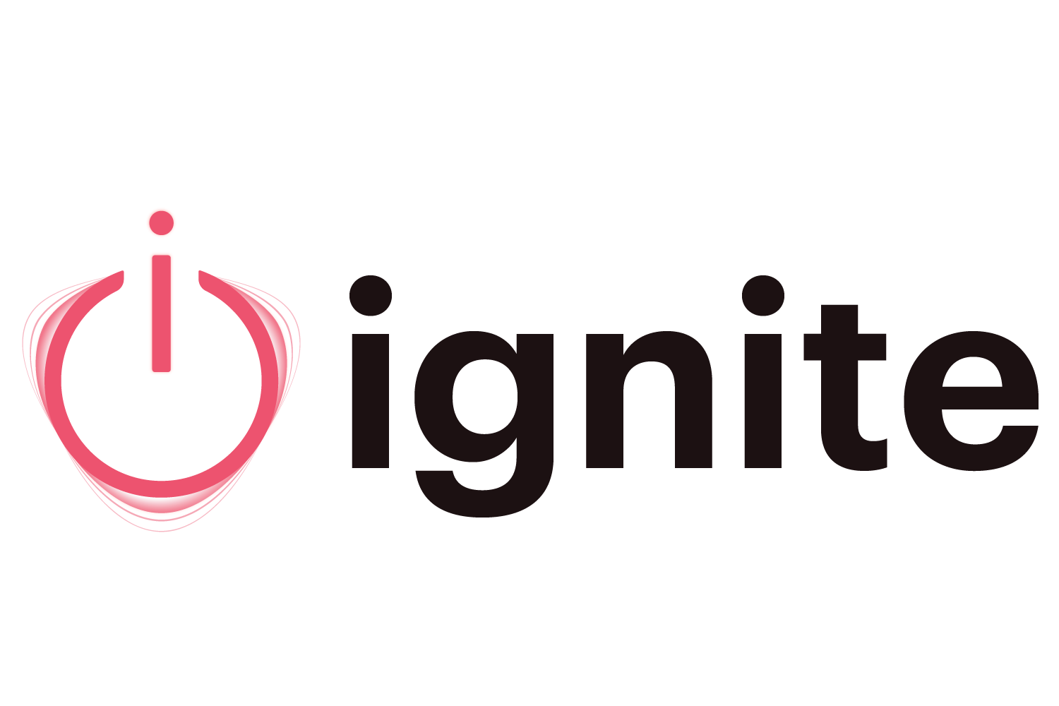
milestones
Month 10
Design and VET
3-month review
Phase 2 coding continues
Fuse build continues
AI alpha review
Phase 3 planning starts
GTM planning
Month 12
Code & Test
5-month review
GTM
Website launches
Phase 3 design starts
Month 9
BUILD THE FOUNDATION
2-month review
Start Phase 2 coding
AI development continues
GTM planning
Month 11
Build & Code
4-month review
Launch AI beta to production
Fuse MVP complete
Phase 2 coding complete
Test Phase 2 code with users
GTM planning

Slide 30
milestones
Month 10
Design and VET
3-month review
Phase 2 coding continues
Fuse build continues
AI alpha review
Phase 3 planning starts
GTM planning
Month 12
Code & Test
5-month review
GTM
Website launches
Phase 3 design starts
Month 9
BUILD THE FOUNDATION
2-month review
Start Phase 2 coding
AI development continues
GTM planning
Month 11
Build & Code
4-month review
Launch AI beta to production
Fuse MVP complete
Phase 2 coding complete
Test Phase 2 code with users
GTM planning

Slide 31





meet the
team
kate burda
The Firestarter
Three decades of experience leading global teams
Proven track record driving innovation
Fosters a culture of excellence
eddie westerfield
Swiss Army Knife
Strong background in product development and operations
Developed multiple tech startups that were spun off and sold.
david garrard
Chief Connector
A seasoned marketing professional who drives strategies to boost brand
Innovative storytelling solidifies visibility and company leadership.
recardo poole
Font end UI and UX designer and engineer with 7 years of experience
Part of the team at Maker OS that sold to Shapeways in 2022
joe tavares
Chief architect / Data and AI expert
Cybersecurity and Blockchain consultant
Co-founded Maker OS, which was sold to Shapeways in 2022

Slide 32


ignite
next steps
Ignite is transforming revenue strategy with our revolutionary platform. If you’d like to experience the power of Ignite, there are several ways to stay informed.
schedule a demo
Experience Ignite's capabilities through a personalized demo.
contact sales
Connect with our experts to identify the best plan for your business.
join our webinars
Join us to learn about Ignite's latest features, use cases, and best practices.

Slide 33


thank you
do less. make it mean more.
w w w . i g n i t e n o w . i o

